Slide 1
Single-Dimensional Arrays

Slide 2
Opening Problem
Read one hundred numbers, compute their average, and find out how many numbers are above the average.

Slide 3
Objectives
To describe why arrays are necessary in programming
To declare array reference variables and create arrays
To obtain array size using arrayRefVar.length and know default values in an array
To access array elements using indexes
To declare, create, and initialize an array using an array initializer.
To program common array operations (displaying arrays, summing all elements, finding the minimum and maximum elements and shifting elements)
To copy contents from one array to another.
To search elements using the linear
To sort an array using the selection sort approach
To pass arguments to the main method from the command line.

Slide 4
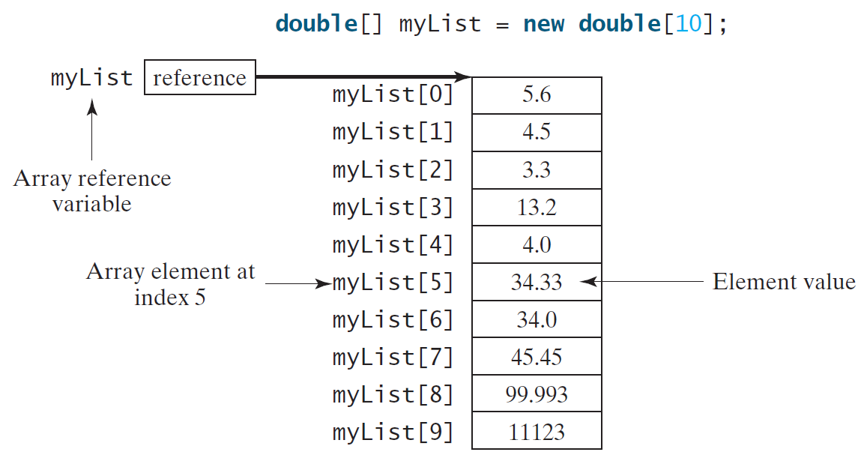
Introducing Arrays
Array is a data structure that represents a collection of the same types of data.

Slide 5
Declaring Array Variables
datatype[] arrayRefVar;
Example:
double[] myList;
datatype arrayRefVar[]; // This style is allowed, but not preferred
Example:
double myList[];

Slide 6
Creating Arrays
arrayRefVar = new datatype[arraySize];
Example:
myList = new double[10];
myList[0] references the first element in the array.
myList[9] references the last element in the array.

Slide 7
Declaring and Creating in One Step
datatype[] arrayRefVar = new
datatype[arraySize];
double[] myList = new double[10];
datatype arrayRefVar[] = new datatype[arraySize];
double myList[] = new double[10];

Slide 8
The Length of an Array
Once an array is created, its size is fixed. It cannot be changed. You can find its size using
arrayRefVar.length
For example,
myList.length returns 10

Slide 9
Default Values
When an array is created, its elements are assigned the default value of
0 for the numeric primitive data types,
'\u0000' for char types, and
false for boolean types.

Slide 10
Indexed Variables
The array elements are accessed through the index. The array indices are 0-based, i.e., it starts from 0 to arrayRefVar.length-1. In the example in Figure 6.1, myList holds ten double values and the indices are from 0 to 9.
Each element in the array is represented using the following syntax, known as an indexed variable:
arrayRefVar[index];

Slide 11
Using Indexed Variables
After an array is created, an indexed variable can be used in the same way as a regular variable. For example, the following code adds the value in myList[0] and myList[1] to myList[2].
myList[2] = myList[0] + myList[1];

Slide 12
Array Initializers
Declaring, creating, initializing in one step:
double[] myList = {1.9, 2.9, 3.4, 3.5};
This shorthand syntax must be in one statement.

Slide 13
Declaring, creating, initializing Using the Shorthand Notation
double[] myList = {1.9, 2.9, 3.4, 3.5};
This shorthand notation is equivalent to the following statements:
double[] myList = new double[4];
myList[0] = 1.9;
myList[1] = 2.9;
myList[2] = 3.4;
myList[3] = 3.5;

Slide 14
Trace Program with Arrays
animation
Declare array variable values, create an array, and assign its reference to values
public class Test {
public static void main(String[] args) {
int[] values = new int[5];
for (int i = 1; i < 5; i++) {
values[i] = i + values[i-1];
}
values[0] = values[1] + values[4];
}
}

Slide 15
Trace Program with Arrays
animation
i becomes 1
public class Test {
public static void main(String[] args) {
int[] values = new int[5];
for (int i = 1; i < 5; i++) {
values[i] = i + values[i-1];
}
values[0] = values[1] + values[4];
}
}

Slide 16
Trace Program with Arrays
animation
i (=1) is less than 5
public class Test {
public static void main(String[] args) {
int[] values = new int[5];
for (int i = 1; i < 5; i++) {
values[i] = i + values[i-1];
}
values[0] = values[1] + values[4];
}
}

Slide 17
Trace Program with Arrays
animation
After this line is executed, value[1] is 1
public class Test {
public static void main(String[] args) {
int[] values = new int[5];
for (int i = 1; i < 5; i++) {
values[i] = i + values[i-1];
}
values[0] = values[1] + values[4];
}
}

Slide 18
Trace Program with Arrays
animation
After i++, i becomes 2
public class Test {
public static void main(String[] args) {
int[] values = new int[5];
for (int i = 1; i < 5; i++) {
values[i] = i + values[i-1];
}
values[0] = values[1] + values[4];
}
}

Slide 19
Trace Program with Arrays
animation
i (= 2) is less than 5
public class Test {
public static void main(String[] args) {
int[] values = new int[5];
for (int i = 1; i < 5; i++) {
values[i] = i + values[i-1];
}
values[0] = values[1] + values[4];
}
}

Slide 20
Trace Program with Arrays
animation
After this line is executed,
values[2] is 3 (2 + 1)
public class Test {
public static void main(String[] args) {
int[] values = new int[5];
for (int i = 1; i < 5; i++) {
values[i] = i + values[i-1];
}
values[0] = values[1] + values[4];
}
}

Slide 21
Trace Program with Arrays
animation
After this, i becomes 3.
public class Test {
public static void main(String[] args) {
int[] values = new int[5];
for (int i = 1; i < 5; i++) {
values[i] = i + values[i-1];
}
values[0] = values[1] + values[4];
}
}

Slide 22
Trace Program with Arrays
animation
i (=3) is still less than 5.
public class Test {
public static void main(String[] args) {
int[] values = new int[5];
for (int i = 1; i < 5; i++) {
values[i] = i + values[i-1];
}
values[0] = values[1] + values[4];
}
}

Slide 23
Trace Program with Arrays
animation
After this line, values[3] becomes 6 (3 + 3)
public class Test {
public static void main(String[] args) {
int[] values = new int[5];
for (int i = 1; i < 5; i++) {
values[i] = i + values[i-1];
}
values[0] = values[1] + values[4];
}
}

Slide 24
Trace Program with Arrays
animation
After this, i becomes 4
public class Test {
public static void main(String[] args) {
int[] values = new int[5];
for (int i = 1; i < 5; i++) {
values[i] = i + values[i-1];
}
values[0] = values[1] + values[4];
}
}

Slide 25
Trace Program with Arrays
animation
i (=4) is still less than 5
public class Test {
public static void main(String[] args) {
int[] values = new int[5];
for (int i = 1; i < 5; i++) {
values[i] = i + values[i-1];
}
values[0] = values[1] + values[4];
}
}

Slide 26
Trace Program with Arrays
animation
After this, values[4] becomes 10 (4 + 6)
public class Test {
public static void main(String[] args) {
int[] values = new int[5];
for (int i = 1; i < 5; i++) {
values[i] = i + values[i-1];
}
values[0] = values[1] + values[4];
}
}

Slide 27
Trace Program with Arrays
animation
After i++, i becomes 5
public class Test {
public static void main(String[] args) {
int[] values = new int[5];
for (int i = 1; i < 5; i++) {
values[i] = i + values[i-1];
}
values[0] = values[1] + values[4];
}
}

Slide 28
Trace Program with Arrays
animation
i ( =5) < 5 is false. Exit the loop
public class Test {
public static void main(String[] args) {
int[] values = new int[5];
for (int i = 1; i < 5; i++) {
values[i] = i + values[i-1];
}
values[0] = values[1] + values[4];
}
}

Slide 29
Trace Program with Arrays
animation
After this line, values[0] is 11 (1 + 10)
public class Test {
public static void main(String[] args) {
int[] values = new int[5];
for (int i = 1; i < 5; i++) {
values[i] = i + values[i-1];
}
values[0] = values[1] + values[4];
}
}

Slide 30
Processing Arrays
See the examples in the text.
(Initializing arrays with input values)
(Initializing arrays with random values)
(Printing arrays)
(Summing all elements)
(Finding the largest element)
(Finding the smallest index of the largest element)
(Shifting elements)

Slide 31
Initializing arrays with input values
java.util.Scanner input = new java.util.Scanner(System.in);
System.out.print("Enter " + myList.length + " values: ");
for (int i = 0; i < myList.length; i++)
myList[i] = input.nextDouble();

Slide 32
Initializing arrays with random values
for (int i = 0; i < myList.length; i++) {
myList[i] = Math.random() * 100;
}

Slide 33
Printing arrays
for (int i = 0; i < myList.length; i++) {
System.out.print(myList[i] + " ");
}

Slide 34
Summing all elements
double total = 0;
for (int i = 0; i < myList.length; i++) {
total += myList[i];
}

Slide 35
Finding the largest element
double max = myList[0];
for (int i = 1; i < myList.length; i++) {
if (myList[i] > max) max = myList[i];
}

Slide 36
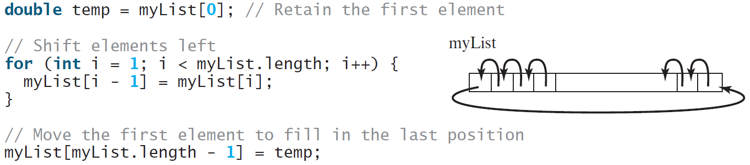
Shifting Elements

Slide 37
Opening Problem
Read one hundred numbers, compute their average, and find out how many numbers are above the average.
Animation
AnalyzeNumbers
Run with prepared input

Slide 38
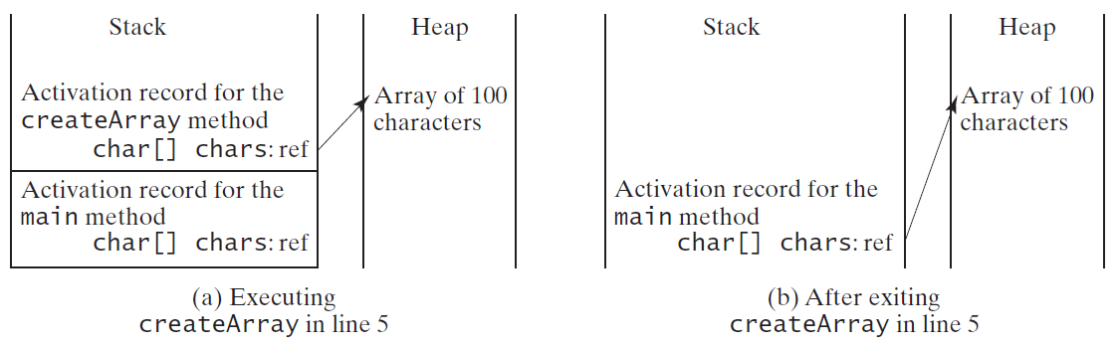
Problem: Counting Occurrence of Each Letter
Generate 100 lowercase letters randomly and assign to an array of characters.
Count the occurrence of each letter in the array.
CountLettersInArray
Run

